Slide 1

Introduction to movie recommendation system

Slide 2
Problem
Everyone’s preference of movie is different
Movies are hit driven – a handful of movie can drive financial success

Slide 3
The Challenge
Apply a recommendation system to market the right movie to the right audience
Improve Effectiveness of advertisements
Sometimes improve visibility for less popular movies

Slide 4
Data
I used the Movielens Data hosted on Kaggle.
Containing 26 million ratings from 270,000 users for all 45,000 movies.
Ratings are on a scale of 1-5 and have been obtained from the official GroupLens website.
Source: https://www.kaggle.com/rounakbanik/the-movies-dataset

Slide 5
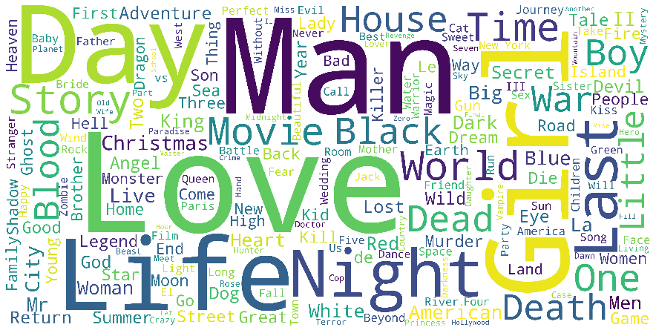
Exploratory analysis
Sample Word Cloud- Title

Slide 6
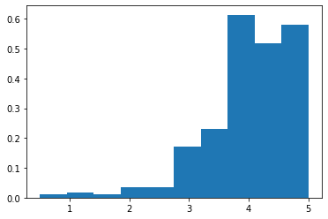
Exploratory Analysis
Ratings

Slide 7
Types of Recommendation system
Content Base
Finding and ranking similarity score
Collaborative
Using Surprise package to predict a single user’s rating
Hybrid

Slide 8
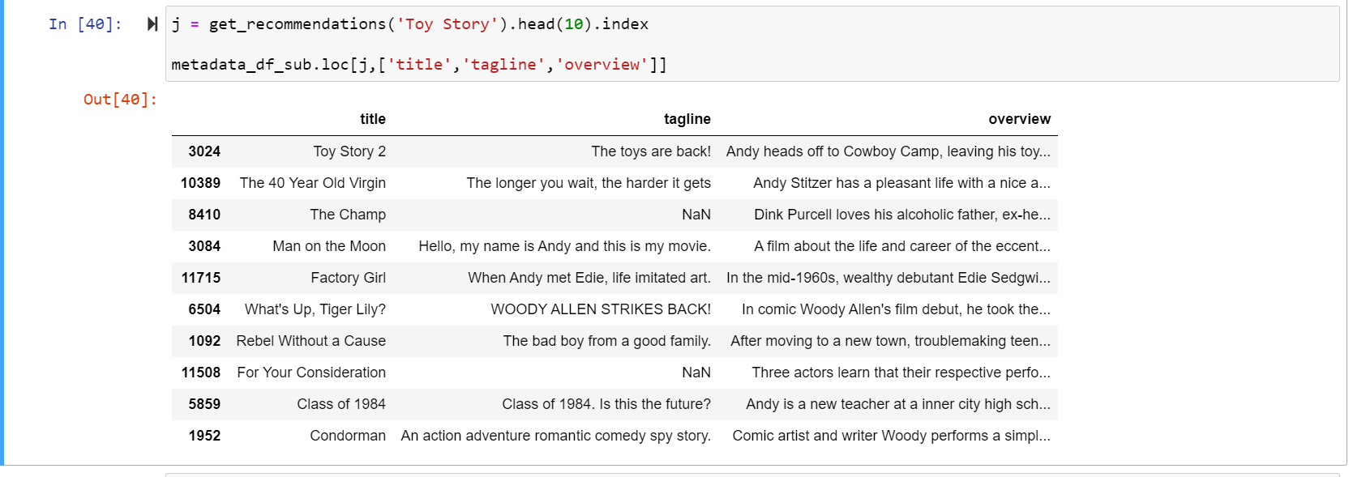
Content Base Filtering
1st attempt using Taglines and Overview and applying TF-IDF Vectorizor

Slide 9
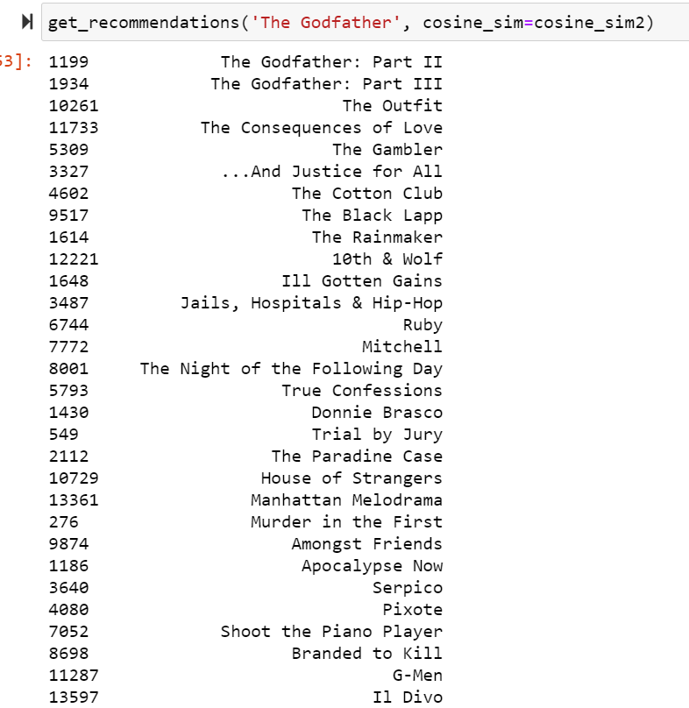
Content Base Filtering
2nd Attempt using Meta Data (Cast, Genre, Keywords, etc)

Slide 10
Collaborative Filtering
Using Surprise Package
Using other users rating to predict the rating of target user

Slide 11
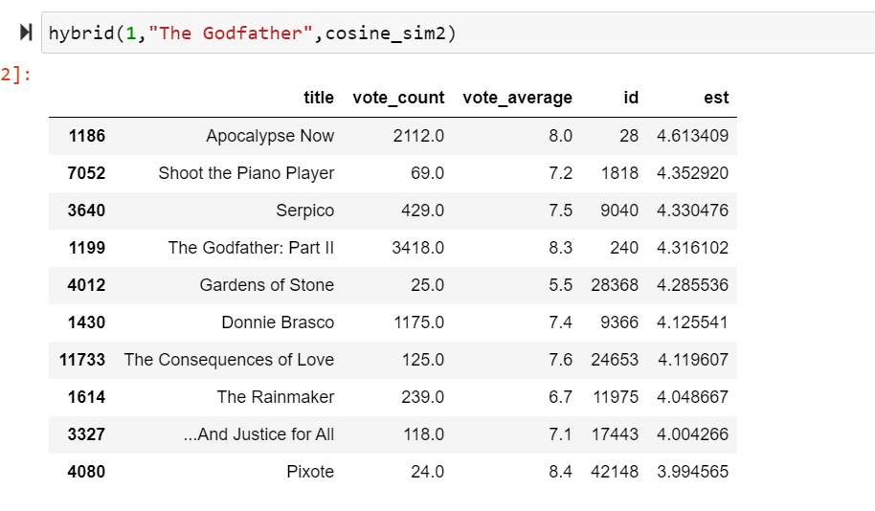
Hybrid Recommender
Content-base filtering first then apply collaborative filtering

Slide 12
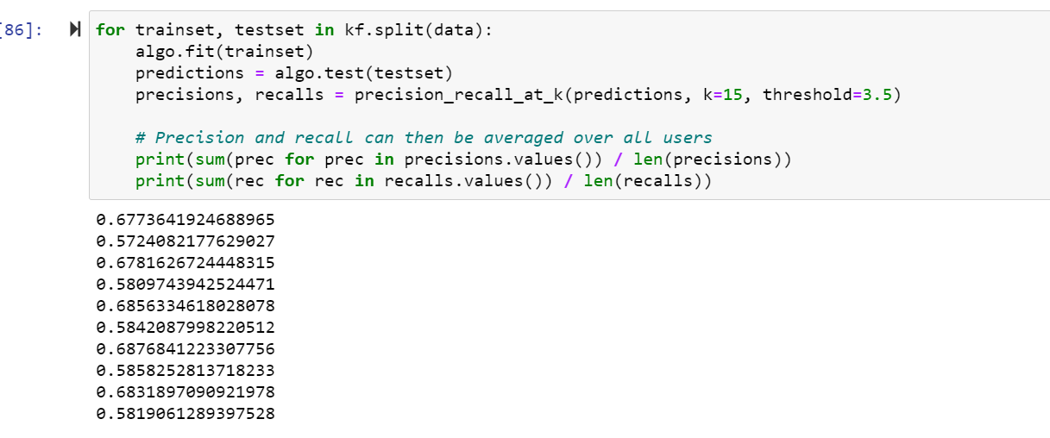
Model Comparison
Precision at K
A method to see at threshold rating K, arbitrarily set, that how many items the system rated at least K or higher for a user
SVD

Slide 13
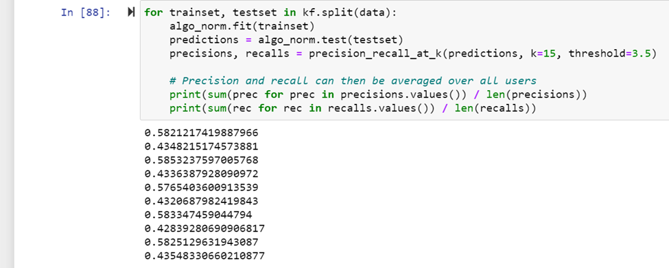
Model Comparison
Precision At K for Baseline

Slide 14
Future consideration
Pre-grouping users with similar rating patterns for Collaborative filtering
Better computer hardware to use more of the data
Tree based model?

